Slide 1
Talk-driven development : Teaching can be a superpower in software engineering
Vaishnavi

Slide 2


Slide 3
Talk Driven Development
Committing to speaking on a particular topic can lead to a developer learning something new in the process of experimenting with new technologies in preparation for a presentation
Teaching brings superpowers that span beyond software development

Slide 5
The Protégé Effect
The protégé effect is a concept in learning that suggests we learn more effectively by teaching information to others, even if those others aren’t necessarily any less knowledgeable.
As author Robert Heinlein puts it, ‘when one teaches, two learn’.

Slide 6
A study published in Memory & Cognition in 2014 determined that just the expectation that one will need to teach can enhance one’s learning and organization of knowledge.
Best times to start teaching something is shortly after learning it

Slide 7


Slide 8
Cascading mentorship model
The cascading mentorship model is another form of teaching that utilizes the benefits of the protégé effect, while adding new benefits.
In the cascading mentorship model, each student is providing mentorship to someone less experienced than them, and same goes for that person, and so on and so forth
This means that everyone – even the most junior person – is involved in an active, peer-led exercise that empowers people on every level of experience to understand their own area of practice more deeply. They are also encouraged to practice their coaching skills, while also analyzing the coaching they receive in order to improve their own skills.

Slide 9


Slide 10
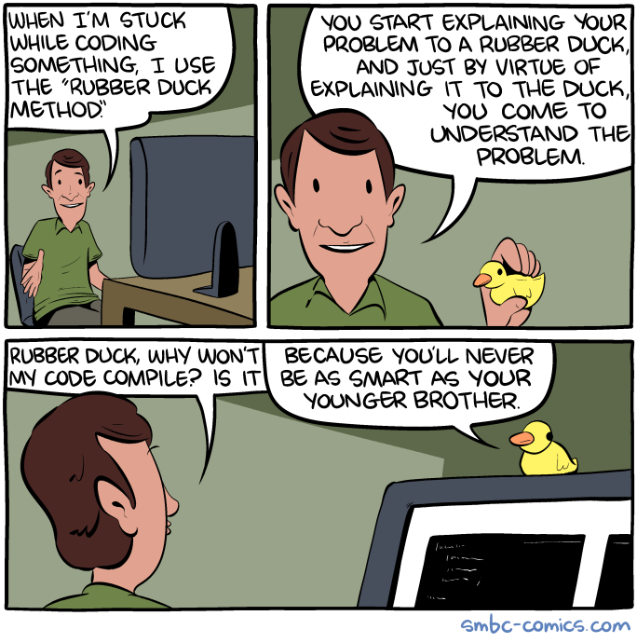

Slide 11
Publishing your work increases your luck

Slide 12
Publishing your work increases your luck
Luck is when something unexpected and good happens to you. Unexpected and good. Who doesn’t want to increase the odds of something unexpected and good?
How can we increase the odds of finding luck? By being a person who works in public. By doing work and being public about it, you build a reputation for yourself. You build a track record. You build a public body of work that speaks on your behalf better than any resume ever could.

Slide 13
SODOTO
See one — See a procedure and observe how it’s done.
Do one — Do the procedure and practice it.
Teach one — Teach someone else how to do the procedure.
Teaching isn’t just for the person receiving the lesson. It’s for you too
Notes:
Often utilized for apprenticeships, SODOTO is an effective means to teach an in-demand technical skill or task to large volumes of students. The method is used to teach new procedures to engineers, law enforcement officers, medical students and practitioners. SODOTO is used also used frequently in field exercises in preparation for crisis situations and combat zones.

Slide 14
Luck Surface Area
Coined by Jason Roberts
START DOING, AMPLIFY WITH TELLING.
The goal is not to become famous, the goal is to increase the chances of luck finding us.

Slide 15
Luck Surface Area
"The amount of serendipity that will occur in your life, your Luck Surface Area, is directly proportional to the degree to which you do something you’re passionate about combined with the total number of people to whom this is effectively communicated.“
Notes:
Jason Roberts : https://twitter.com/exojason?lang=en
Coder, entrepreneur, and podcaster
@techzing

Slide 16
L = D * T, where L is luck, D is doing and T is telling.
Luck = (Passionate) Doing x (Effective) Telling.
The more things you do multiplied by the more people you tell, the larger your Luck Surface Area becomes. The larger your Luck Surface Area, the more likely you are to catch luck as it flows by.
when people become aware of your expertise, some percentage of them will take action to capture that value, but quite often it will be in a way you would never have predicted.”
Roberts also pointed to the infectious nature of passion, and that taking action and sharing your passion will tend to attract others towards it, again amplified by the number of people who know about it.

Slide 17
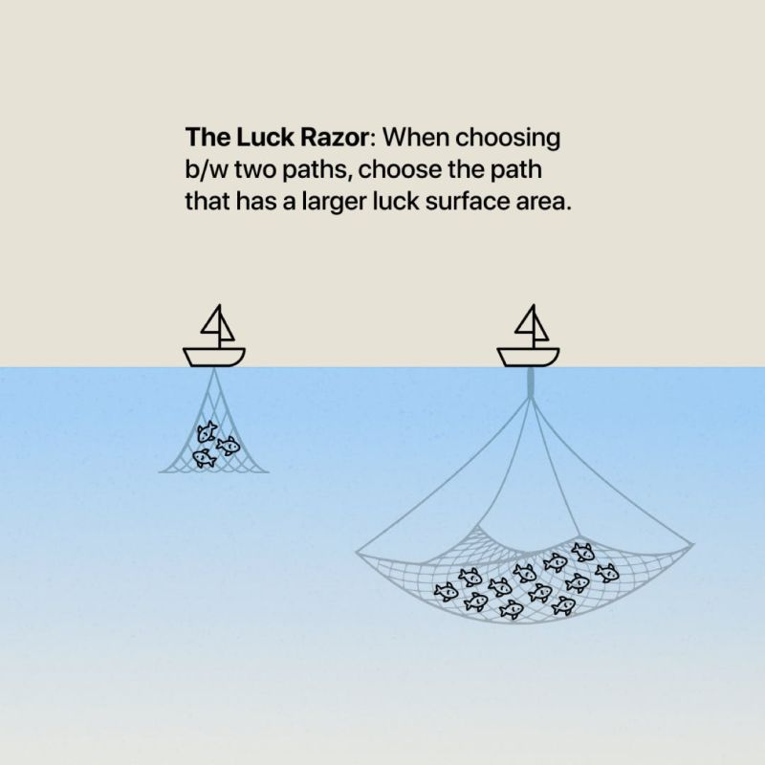

Slide 18
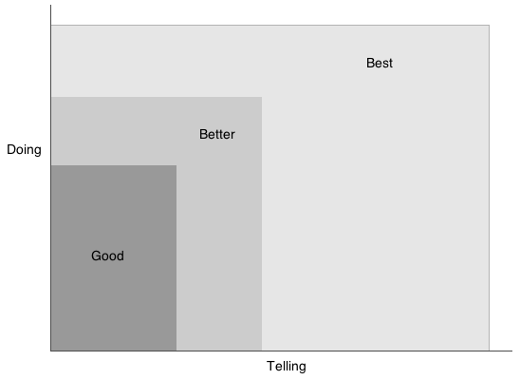

Slide 19
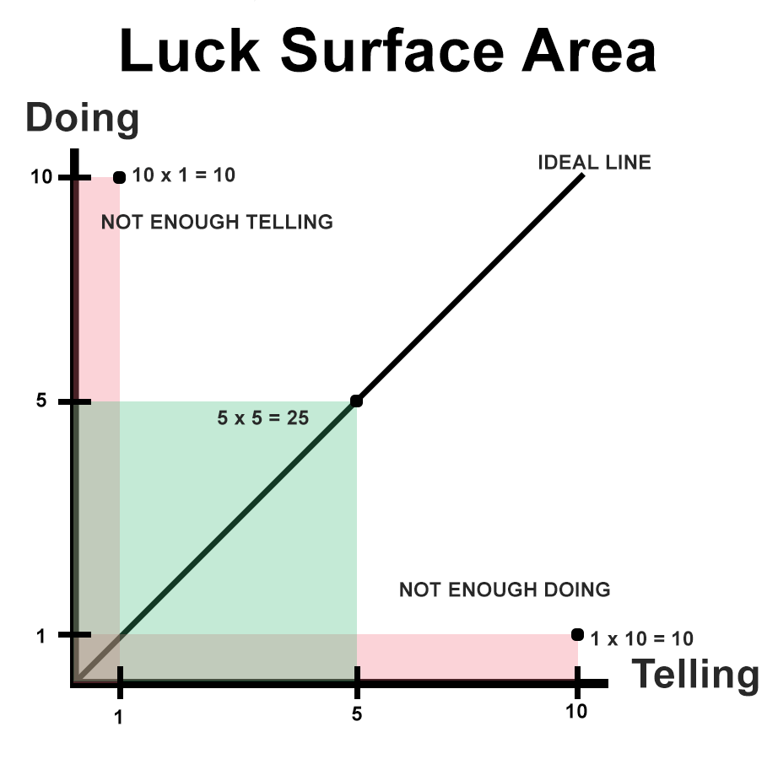

Slide 20
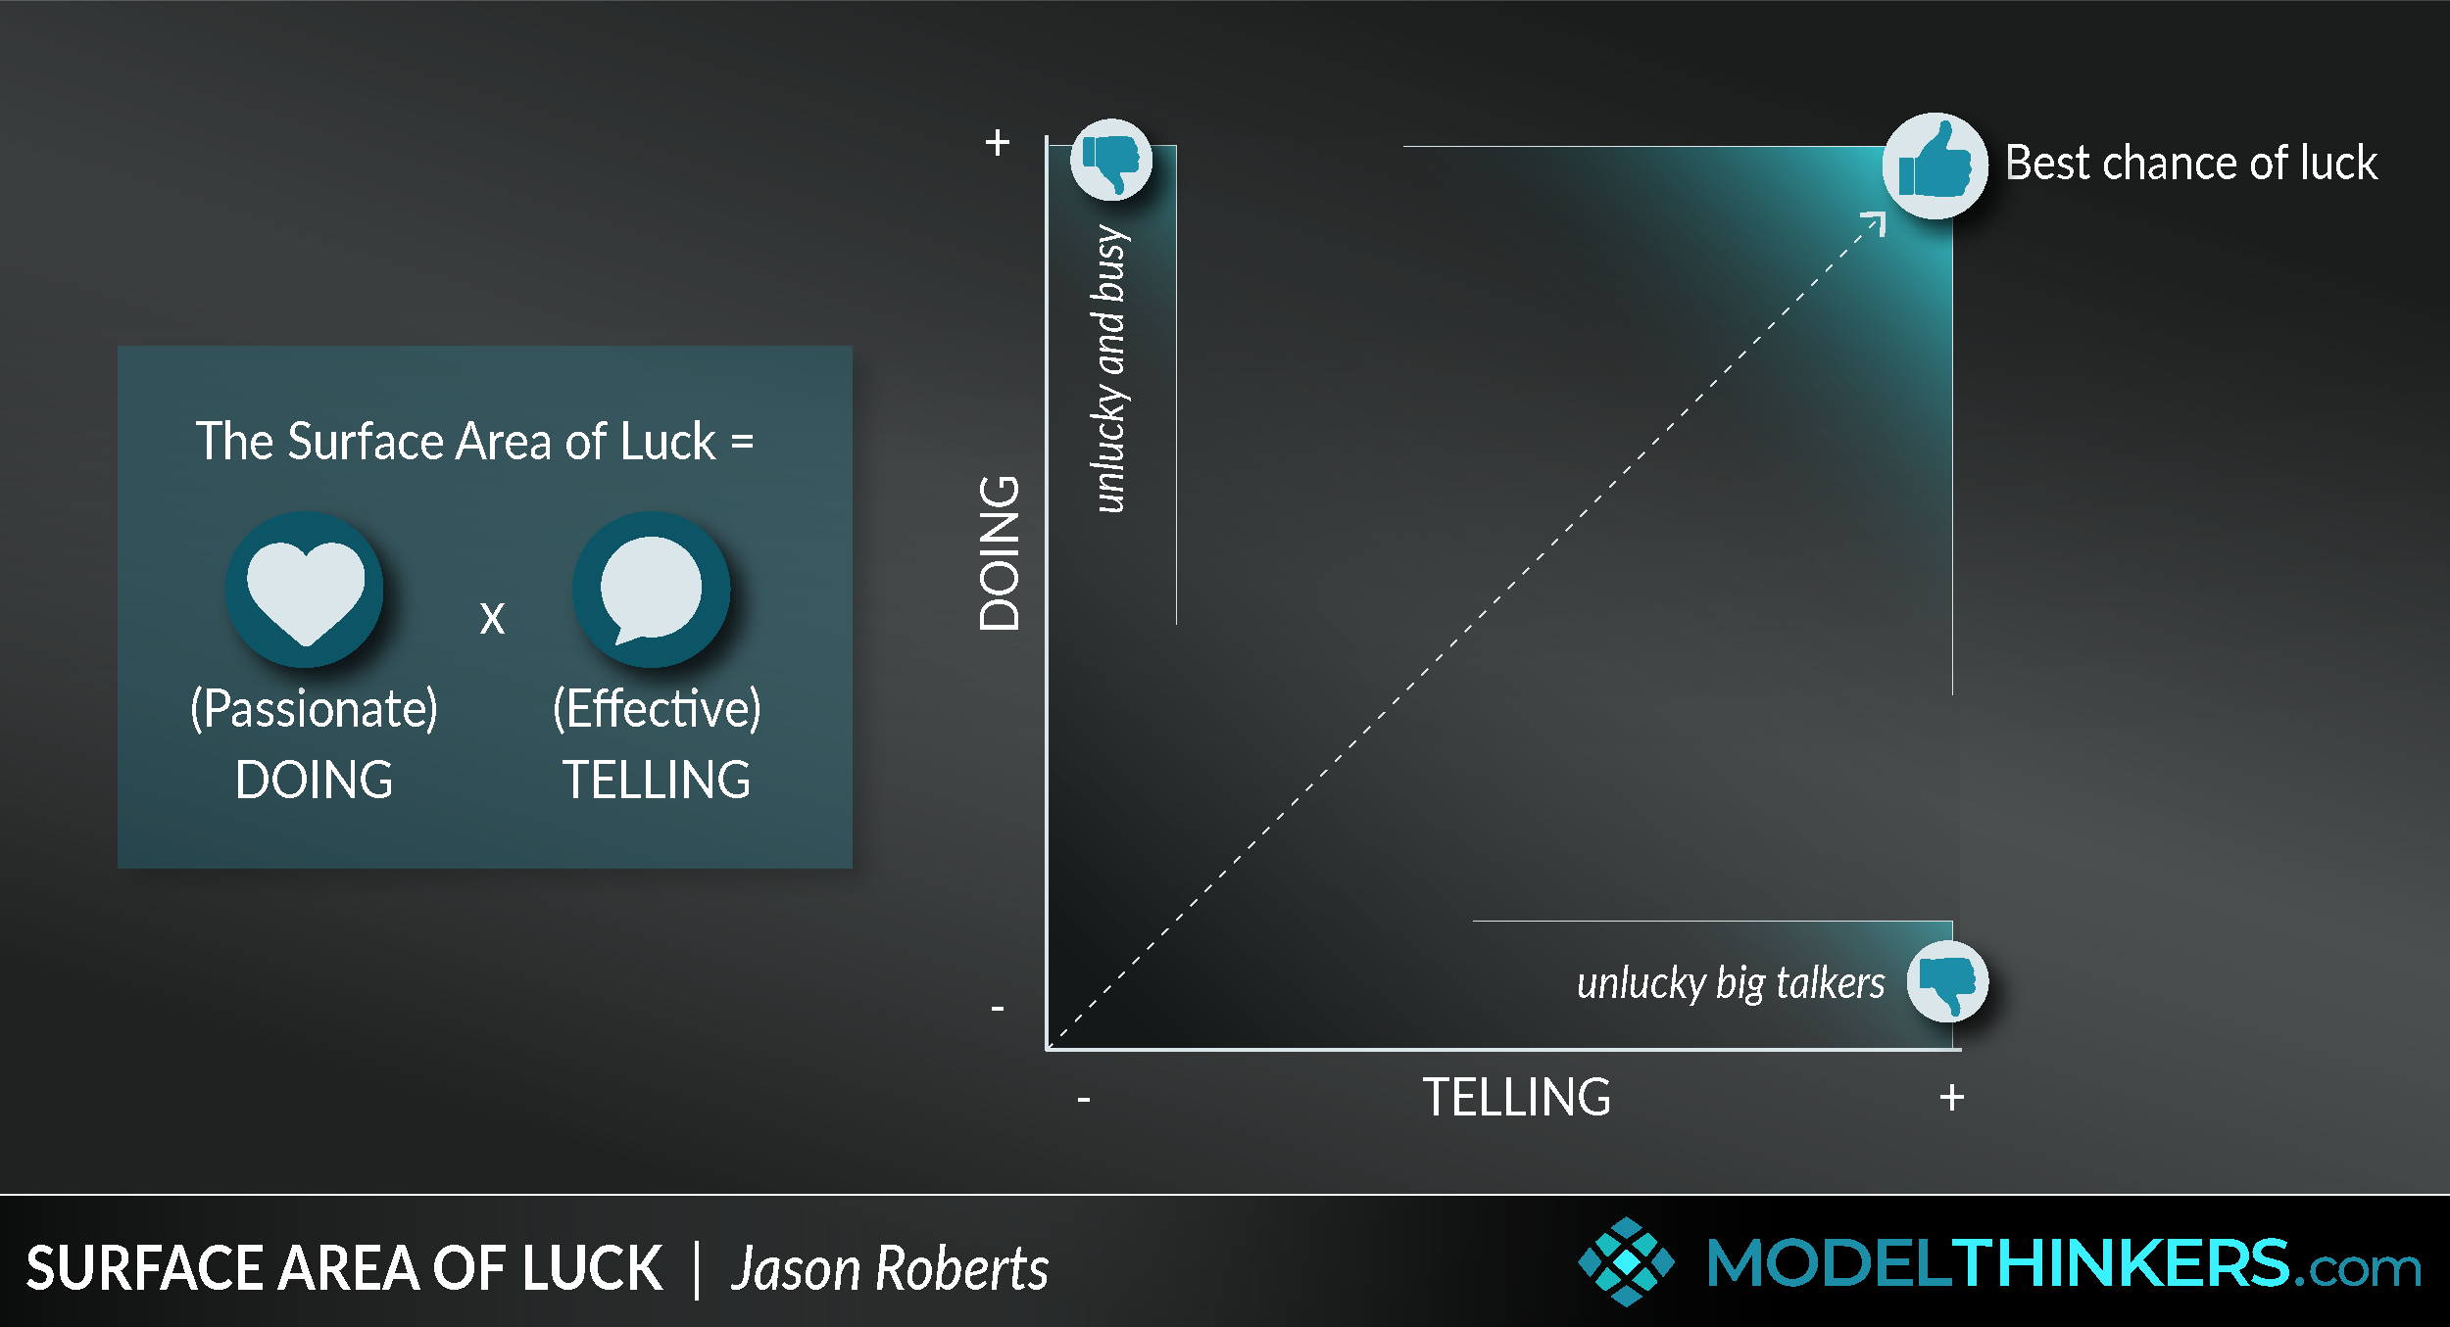

Slide 21
The law of averages refers the common belief that the relative frequency of an event should correspond to its probability. For example, if the probability of heads in a fair coin toss is 50%, then according to the law of averages, the proportion of heads in a series of tosses should be close to 50%.

Slide 22
Tina Seelig, Stanford professor and the creator of Framestorming, has been studying entrepreneurs and luck for some time. Her reframing of how to view luck aligns well with this model.
Seelig explains: “Luck is rarely a lightning strike, isolated and dramatic. It’s much more like the wind, blowing constantly. Sometimes it’s calm, and sometimes it blows in gusts. And sometimes it comes from directions that you didn’t even imagine.

Slide 23
Whatever you’re excited about, be excited about it publicly.
blogging, podcasting, commenting in online discussions, and following up with every customer and user, you increase the likelihood of having a serendipitous moment. It’s a fun concept to consider – but perhaps less of a scientific occurrence than yet another example of the Law of Averages.

Slide 24
This includes engaging with people from a place of care and generosity rather than focusing on selling or personal gain. It also means connecting with the right platforms and communities who might be interested in what you’re doing and are passionate about.

Slide 25
Share Your Learnings at a Sustainable Pace
Atomic Habits by James Clear is that, over time, it’s generally more impactful to make small, consistent progress towards an identity-based goal (like being someone who runs regularly) than inconsistently focusing on one huge goal (like running a marathon).
Teaching reveals gaps in our knowledge. When we're aware of those gaps, we become more humble, and we ask more question

Slide 26
process, care, and craft
Digital gardening embraces the idea that the process of documenting is more important than the final presentation.

Slide 27

“The person who says he knows what he thinks but cannot express it usually does not know what he thinks.” — Mortimer Adler

Slide 28

What’s your superpower?

Slide 29
References
https://www.swyx.io/create-luck
https://github.com/readme/guides/publishing-your-work
https://modelthinkers.com/mental-model/surface-area-of-luck
https://github.com/readme/guides/public-documentation
https://www.skmurphy.com/blog/2019/04/03/increase-your-luck-surface-area-to-get-more-customers/

